Slide 1
Agents Tracking Food with Reinforcement Learning
Alexander Mervar | April 25, 2022

Slide 2
Inspiration
Braitenberg Vehicles
The Cart/Pole Problem
Deepmind’s Work with RL

Slide 3
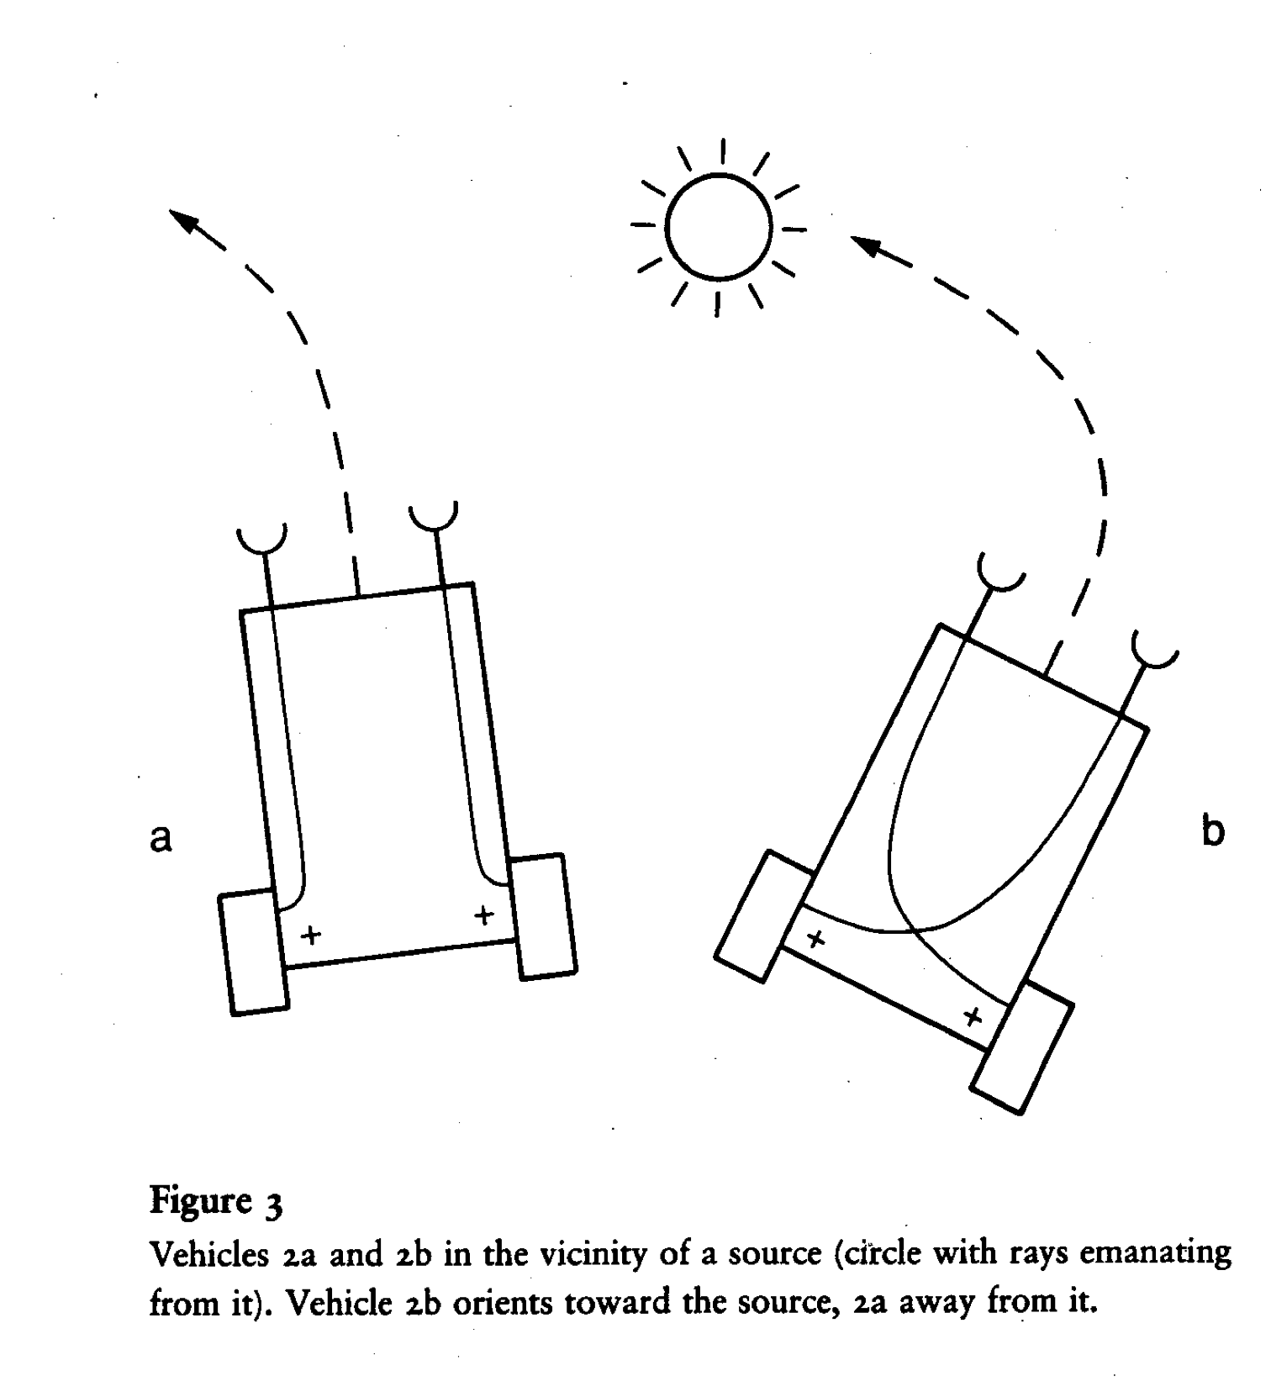
Issues to Address
What are Braitenberg vehicles
Literature Review
Braitenberg RL Environment
Continuous Action Spaces
What are Braitenberg vehicles

Slide 4
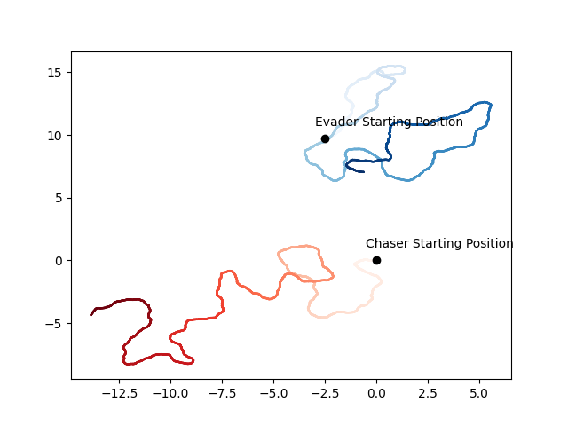

Slide 5
The Plan
Create an agent to track an object in 2D Space
Use reinforcement learning to guide movement
Have the goal object move?
Have an adversarial agent?
What could go wrong?

Slide 6
Where I’m Headed
and what I hope to learn

